Slide 1
Module 2
System Architecture & Agents Planning

Slide 2
Why Planning Agent Roles is Important?
Clarity of Responsibilities – Avoids overlapping logic between agents
Improves Reliability – Reduces hallucination & tool misuse by enforcing role-specific constraints
Modular Debugging – Easier to test, update, or replace individual agents
Performance Optimization – Streamlined interactions reduce LLM calls and cost
Better Evaluation – Enables targeted evaluation of agent decisions and outputs

Slide 3
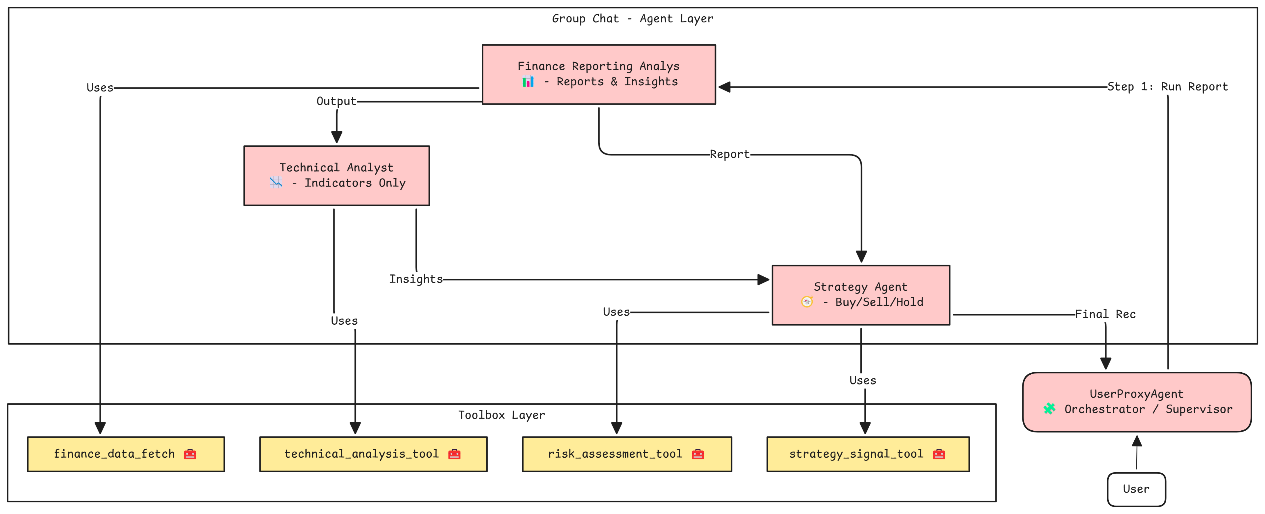
Agents and Tools for Financial Analysis

Slide 4
Agent 1 – Finance Reporting Analyst
Role: Generate markdown-based financial reports from stock data
Responsibilities:
Fetch data via tools
Compute financial metrics, ratios
Create initial analysis report in a markdown format
Constraints: No hallucinations, must reflect uncertainty
Tool Used: finance_data_fetch

Slide 5
Agent 2 – Technical Analyst
Role: Perform technical analysis using predefined indicators
Responsibilities:
Analyze SMA, EMA, RSI, Last Close Price
Identify trends, patterns, and trading signals
Constraints:
No summaries or financial reports
Does not handle performance overview
No direct human input handling
Tool: technical_analysis_tool

Slide 6
Agent 3 – Strategy Agent
Role: Recommend Buy/Sell/Hold actions and assess risk
Responsibilities:
Analyze trading signals: MACD, RSI, Last Close
Evaluate risk: Volatility, Beta, Dividend Yield
Provide rationale behind recommendation
Decision Logic:
Buy if MACD > Signal and RSI < 70
Sell if MACD < Signal or RSI > 70
Hold if indicators are conflicting
Tools: risk_assessment_tool, strategy_signal_tool

Slide 7
Agent 4 – Orchestrator (UserProxyAgent)
Role: Coordinates the overall workflow
Responsibilities:
Initiates the reporting agent for data and analysis
Passes output to reporting agent and technical analyst
Invokes strategy agent with combined inputs
Presents a final summary to the user
Rules:
Do not invent information
Use only available tools and agent outputs
Handle failures gracefully

